Slide 1
What I Have Done So Far
Weekly meeting with Prof. Mohd M. Sabry
Read 7 research papers:
Digital neuromorphic chips for deep learning inference: a comprehensive study
An Electronic Synapse Device Based on Metal OxideResistive Switching Memory forNeuromorphic Computation
A System-Level Simulator for RRAM-Based Neuromorphic Computing Chips
Neuromorphic Architectures for Spiking Deep Neural Networks
Conversion of Artificial Recurrent Neural Networks to Spiking Neural Networks for Low-power Neuromorphic Hardware
Spiking Deep Convolutional Neural Networks for Energy-Efficient Object Recognition
CBRAM Devices as Binary Synapses for Low-Power Stochastic Neuromorphic Systems: Auditory (Cochlea) and Visual (Retina) Cognitive Processing Application
Setting up of Cadence IDE and made first cell structure

Slide 2
Coming Up (Long term)
Design and simulate regular neuromorphic circuit with core architecture
Understand Neuromorphic conversion process: using abs() and tanh() ->halfRect()
Connected Neuromorphic Network -> Tailored Connected Neuromorphic Network -> Spiking Connected Neuromorphic Network
Design and simulate Spike based neuromorphic circuit with MRAM core architecture

Slide 3
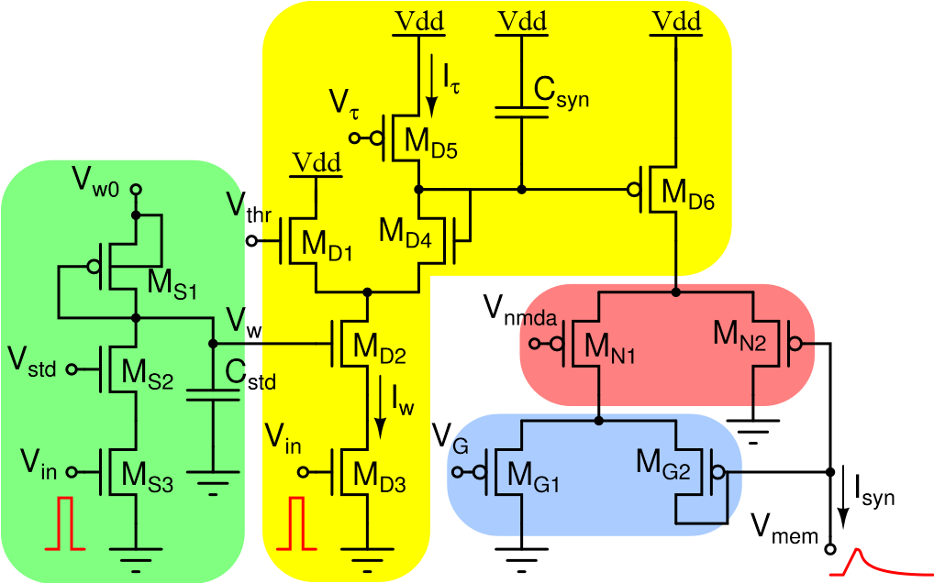
Near term (Next week)
Implement a single unit electronic synaptic design from research journal as tutorial

Slide 4
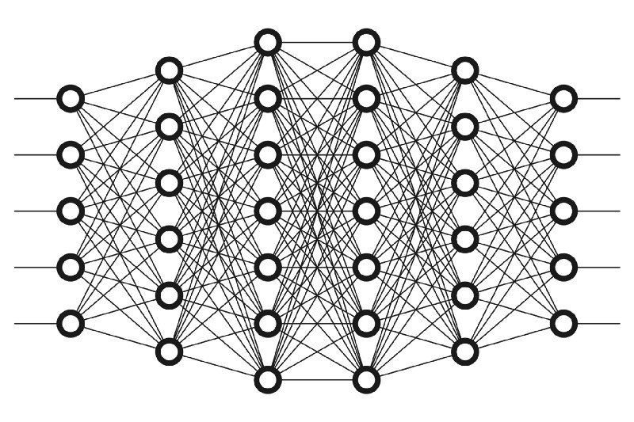
Deep Learning Fully Connected Network

Slide 5
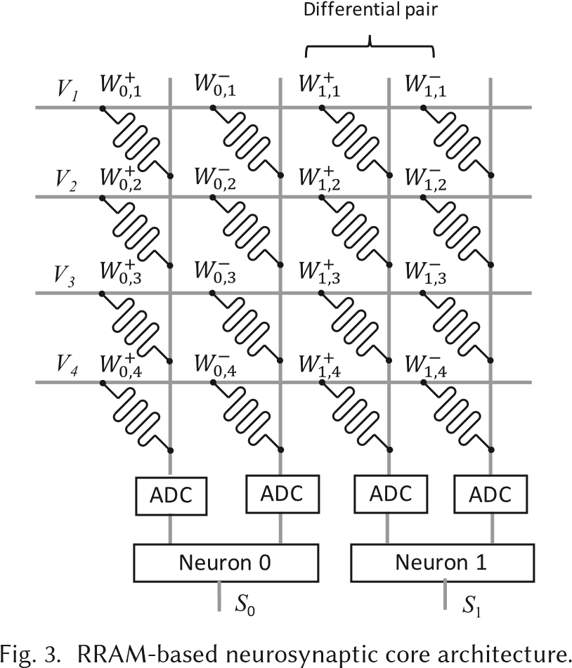
Neuromorphic Array Architecture

Slide 6
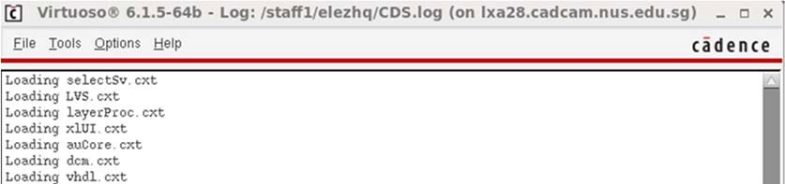
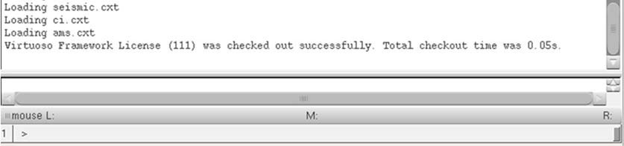
Cadence Virtuoso (Command Input Window)

Slide 7
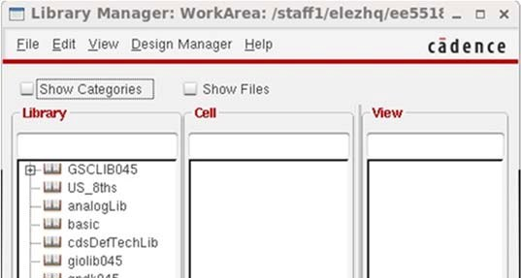
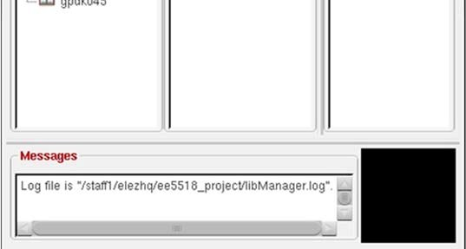
Cadence Virtuoso (Library Manager Window)

Slide 8
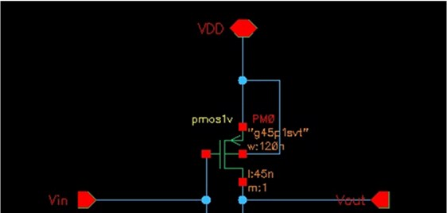
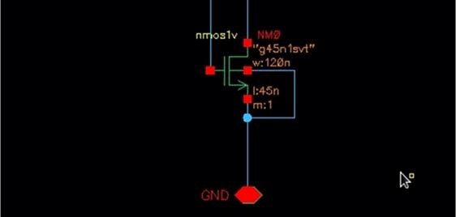
Cadence Virtuoso (Schematic)

